Slide 1

DSCI-6004 NLP
Project Proposal
Team Of
Kata Revanth
Alluri Sri Ram
Sohith Chinnam

Slide 2

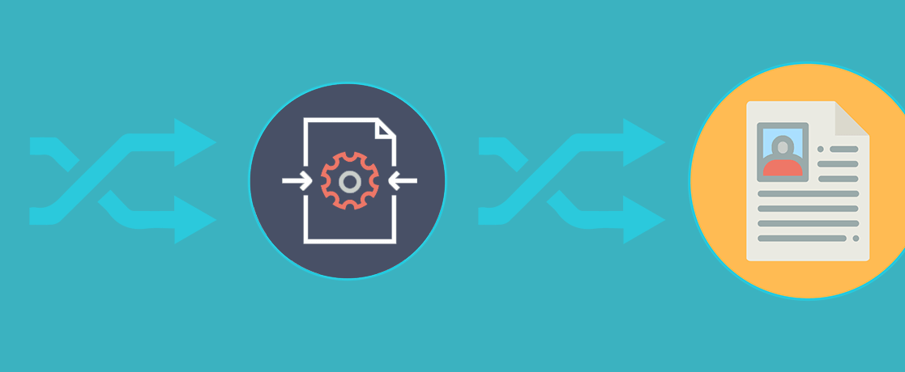
Resume Screener

Slide 3
Objective
Resume Parser aims to speed up screening process of a candidate.
In the recruitment process, it is inefficient, slow, and costly to scan with hundreds of resumes one by one based on the skill-set.
Resume parser automates the screening.
Resume parsing is tricky. There are hundreds of ways of doing it.
Our Resume screener aims to speed up screening process of a candidate. Given a bulk of resumes, a Resume Screener outputs the top N candidtes for the described role.
●
●
●
●

Slide 4
Why our Resume Screener?
Speeding up the recruitment process Spend more time on the best candidates
Increased automation, reaching best candidates
●
●
●

Slide 5
Dataset
●
https://www.kaggle.com/datasets/gauravduttakiit/resume-d ataset
https://github.com/JAIJANYANI/Automated-Resume-Scree ning-System/tree/master/Original_Resumes

Slide 6
Tools & Techniques
●
Python3
docx2txt and pdfminer.six for extracting text
nltk for NLP (natural language processing) tasks such as stop word filtering and tokenization, parsing, classification, stemming, tagging,Gensim
Performance evaluation - TBD

Slide 7
Project Deliverables
●
Project report (pdf)
Working project src files (.py, .ipynb, etc.) Project demo Video on YouTube
Project PowerPoint presentation
Github Repository with project code and a user documentation manual as a .MD file
●
●
●
●

Slide 8
Reference
●
https://blog.apilayer.com/build-your-own-resume-parser-usi ng-python-and-nlp/
https://www.smartrecruiters.com/resources/glossary/resum e-parsing/
https://github.com/meghnalohani/Resume-Scoring-using-N LP/blob/master/RESUME%20SCORING%20USING%20N LP.pdf
https://www.analyticsvidhya.com/blog/2021/06/resume-scr eening-with-natural-language-processing-in-python/
https://github.com/dhinu95/Resume-Parser-Using-NLP
●
●
●
●

